Slide 1
Creating web 2.0 based teaching & learning materials
INTERNATIONAL CONFERENCE IN EDUCATION (ICE) 19 OCTOBER 2016
MERITZ HOTEL, MIRI, SARAWAK

Slide 2
Hello!
Join us here:
http://goingdigitalkotakinabalu.weebly.com/ice-2016.html

Slide 3
21st Century Teacher
What does it mean?
Let’s brainstorm:
https://answergarden.ch/310133

Slide 4
Using Technology in the Classroom
What do you feel about using technology in the classroom?
What are your challenges?
How do you overcome it?

Slide 5
Let’s brainstorm with Padlet!
https://padlet.com/cindyjbj79/x51ee3y1cg2p
Or
The shorter one:
http://bit.do/Going-Digital-Padlet

Slide 6
What is TPACK?
VIDEO
Youtube link:
https://youtu.be/FagVSQlZELY

Slide 7
KAHOOT IT!
Quiz:
https://play.kahoot.it/#/?quizId=da0d668a-e828-4867-b9ed-44af184d8383
URL too long!

Slide 8
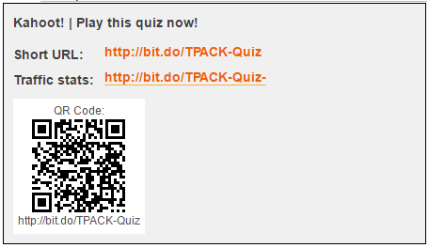
Okay, this the shorter version...

Slide 9
Using Stumbling Blocks as Stepping Stones
VIDEO
Youtube link:
https://youtu.be/WWV5Lj892HU

Slide 10
The Web 2.0 tools we’ve tried out in this session...
Answer Garden (https://answergarden.ch/)
Padlet (https://padlet.com/)
bit.do (https://bit.do/)
Kahoot! (https://getkahoot.com/)

