Slide 1
TPACK & 21ST CENTURY TEACHER
GOING DIGITAL WORKSHOP
(PHASE 2)
25TH JUNE 2016
SK SACRED HEART, KOTA KINABALU

Slide 2
21st Century Teacher
What does it mean?
Let’s brainstorm:
https://answergarden.ch/310133

Slide 3
Using Technology in the Classroom
What do you feel about using technology in the classroom?
What are your challenges?
How do you overcome it?

Slide 4
Let’s brainstorm with Padlet!
https://padlet.com/cindyjbj79/x51ee3y1cg2p
Or
The shorter one:
http://bit.do/Going-Digital-Padlet

Slide 5
What is TPACK?
VIDEO
Youtube link:
https://youtu.be/FagVSQlZELY

Slide 6
KAHOOT!
Quiz:
https://play.kahoot.it/#/k/da0d668a-e828-4867-b9ed-44af184d8383
URL too long!

Slide 7
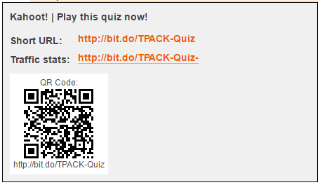
Okay, this the shorter version...

Slide 8
Using Stumbling Blocks as Stepping Stones
VIDEO
Youtube link:
https://youtu.be/WWV5Lj892HU

Slide 9
The digital tools we’ve tried out in this session...
Answer Garden (https://answergarden.ch/)
Padlet (https://padlet.com/)
bit.do (https://bit.do/)
Kahoot! (https://getkahoot.com/)

